Slide 1

Using Big Data To Solve
Economic and Social Problems
Professor Raj Chetty
Head Section Leader Rebecca Toseland
Photo Credit: Florida Atlantic University

Slide 2
Residential Integration and Upward Mobility
Recap of last lecture: helping families with young kids move to mixed-income neighborhoods using vouchers increases upward mobility
Broader lesson: policies that reduce residential segregation likely to increase upward mobility
  Providing tax credits to encourage building affordable properties in higher-income neighborhoods (Low-Income Housing Tax Credit)
  Retaining housing options for low and middle income families as city centers gentrify
  Improved urban planning, e.g. changes in zoning regulations that prevent dense development

Slide 3
Part 1
Local Area Variation in Upward Mobility
A Historical Perspective on the American Dream

Slide 4
Trends in Mobility Over Time
Thus far, we have focused on a snapshot of rates of mobility for children growing up in America today
Often useful to take a historical perspective to understand today’s economic and social challenges
To provide such a perspective, examine trends in mobility over time at the national level

Slide 5
A Historical Perspective on the American Dream
Historically, American Dream has been defined as aspiration that children should have higher standards of living than their parents
  When asked to assess economic progress, children frequently compare their earnings to their parents [Goldthorpe 1987]
  Obama (2014): “People’s frustrations are partly rooted “in the fear that their kids won’t be better off than they were”
What fraction of children earn more than their parents, and how has this changed over time?
Reference: Chetty, Grusky, Hell, Hendren, Manduca, Narang. “The Fading American Dream: Trends in Absolute Income Mobility Since 1940.” Science 2017.

Slide 6


Slide 7
Measuring the American Dream
Key data problem for studying historical trends in mobility: lack of large datasets linking parents and children
We solve this problem by combining Census data back to 1940 with recent data from de-identified tax records

Slide 8
Percent of Children Earning More than their Parents
By Parent Income Percentile
100
1940
80
60
Pct. of Children Earning more than their Parents
40
20
0
0
20
40
60
80
100
Parent Income Percentile

Slide 9
Percent of Children Earning More than their Parents
By Parent Income Percentile
100
1940
80
1950
60
Pct. of Children Earning more than their Parents
40
20
0
0
20
40
60
80
100
Parent Income Percentile

Slide 10
Percent of Children Earning More than their Parents
By Parent Income Percentile
100
1940
80
1950
60
1960
Pct. of Children Earning more than their Parents
40
20
0
0
20
40
60
80
100
Parent Income Percentile

Slide 11
Percent of Children Earning More than their Parents
By Parent Income Percentile
100
1940
80
1950
60
1960
Pct. of Children Earning more than their Parents
40
1970
20
0
0
20
40
60
80
100
Parent Income Percentile

Slide 12
Percent of Children Earning More than their Parents
By Parent Income Percentile
100
1940
80
1950
60
1960
Pct. of Children Earning more than their Parents
40
1970
1980
20
0
0
20
40
60
80
100
Parent Income Percentile

Slide 13
Percent of Children Earning More than Their Parents, by Birth Cohort
100
90
80
Pct. of Children Earning more than their Parents
70
60
50
1940
1950
1960
1970
1980
Child's Birth Cohort

Slide 14
Household Income Distributions of Parents and Children at Age 30
For Children in 1940 Birth Cohort
Density
Parents
Children
0
27k
50k
100k
150k
Income (Measured in Real 2014$)

Slide 15
Household Income Distributions of Parents and Children at Age 30
For Children in 1940 Birth Cohort
80th percentile of parents distribution
Density
Parents
Children
0
27k
50k
100k
150k
Income (Measured in Real 2014$)

Slide 16
Household Income Distributions of Parents and Children at Age 30
For Children in 1940 Birth Cohort
80th percentile of parents distribution
Density
14th percentile of children's distribution
Parents
Children
0
27k
50k
100k
150k
Income (Measured in Real 2014$)

Slide 17
Household Income Distributions of Parents and Children at Age 30
For Children in 1980 Birth Cohort
80th percentile of parents distribution
Density
74th percentile of children's distribution
Parents
Children
0
50k
80k
100k
150k
Income (Measured in Real 2014$)

Slide 18
What Policies Can Revive Absolute Mobility?
Two key macroeconomic changes since 1940: lower GDP growth rates and less equal distribution of growth
Consider two hypothetical scenarios for children born in 1980:
  Higher growth: growth rate since birth corresponding to 1940 cohort, with GDP distributed as it is today
  More broadly shared growth: Same GDP growth as today, but distribute GDP across income groups as in 1940 cohort

Slide 19
Percent of Children Earning More than Their Parents: Hypothetical Scenarios
100
Average:91.5%
1940
80
60
Pct. of Children Earning more than their Parents
40
Average:50.0%
1980
20
0
0
20
40
60
80
100
Parent Income Percentile (conditional on positive income)

Slide 20
Percent of Children Earning More than Their Parents: Hypothetical Scenarios
100
Average:91.5%
1940
80
60
Pct. of Children Earning more than their Parents
Average:61.9%
40
Average:50.0%
1980
20
0
Higher growth: 1940 GDP growth rate, 1980 shares
0
20
40
60
80
100
Parent Income Percentile (conditional on positive income)

Slide 21
Percent of Children Earning More than Their Parents: Hypothetical Scenarios
100
Average:91.5%
1940
80
Average:79.6%
60
Pct. of Children Earning more than their Parents
Average:61.9%
40
Average:50.0%
1980
20
More broadly shared growth: 1980 GDP growth, 1940 shares
0
Higher growth: 1940 GDP growth rate, 1980 shares
0
20
40
60
80
100
Parent Income Percentile (conditional on positive income)

Slide 22
Percent of Children Earning More than Their Parents: Hypothetical Scenarios
100
1940 Empirical
90
80
Pct. of Children Earning more than their Parents
70
60
1980 Empirical
50
40
0
2
4
6
8
10
Real GDP/Family Growth Rate (%)

Slide 23
Summary: Reviving the American Dream
Rates of absolute upward mobility have fallen from ~90% for 1940 birth cohort to ~50% for children entering labor market today
Reviving the American Dream of high rates of upward mobility will require more broadly shared economic growth
  Need policies that will increase incomes in the bottom and middle of the income distribution
  Could range from housing vouchers to investments in higher education to worker retraining

Slide 24
Is Increasing Social Mobility Desirable?
Thus far we have assumed that our objective should be to increase mobility
But policies that increase mobility may not be desirable from an efficiency perspective
  Random college admissions would maximize social mobility
  But would violate principle of meritocracy and would likely reduce total economic output and growth
Next, assess tradeoff between mobility and growth, focusing on innovation as a driver of growth

Slide 25
Part 1
Local Area Variation in Upward Mobility
Equality of Opportunity and Economic Growth

Slide 26
Equality of Opportunity and Economic Growth
Question: how does increasing equality of opportunity affect aggregate growth?
Difficult to measure effects on growth directly
  Instead, focus here on a channel that many economists think is the key driver of economic growth: innovation
  Reference: Bell, Chetty, Jaravel, Petkova, and van Reenen. “The Lifecycle of Inventors” Working Paper 2016

Slide 27
Measuring Innovation
Measure innovation using patent data
  Standard proxy for invention in literature, with well known pros and cons
Link universe of patent records in the United States from 1996-2010 to tax records
  Use linked data to study the lives of 750,000 patent holders in the U.S., from birth to adulthood

Slide 28
Patent Rates vs. Parent Income Percentile
8
Patent rate for children
with parents in top 1%:
8.3 per 1,000
6
4
No. of Inventors per Thousand Children
2
Patent rate for children
with parents below median:
0.85 per 1,000
0
0
20
40
60
80
100
Parent Household Income Percentile

Slide 29
Why Do Patent Rates Vary with Parent Income?
Correlation between parent income and children growing up to be inventors could be driven by three mechanisms:
  Endowments: Children from high-income families may have higher innate ability
  Preferences: lower income children may prefer other occupations
  Constraints: lower income children may face greater barriers to entry (poorer environment, lack of funding)

Slide 30
Do Differences in Ability Explain the Innovation Gap?
Measure ability using test score data for children in NYC public schools [Chetty, Friedman, Rockoff 2014]
  Math and English scores from grades 3-8 on standardized tests for 430,000 children born between 1979-84

Slide 31
Distribution of 3rd Grade Math Test Scores
for Children of Low vs. High Income Parents
0.5
0.4
0.3
Density
0.2
0.1
0
-3
-2
-1
0
1
2
3
Grade 3 Math Scores (Standard Deviations Relative to Mean)
Parent Income Below 80th Percentile
Parent Income Above 80th Percentile

Slide 32
Patent Rates vs. 3rd Grade Math Test Scores
5
90th Percentile
4
3
No. of Inventors per Thousand Children
2
1
0
-2
-1
0
1
2
3rd Grade Math Test Score (Standard Deviations Relative to Mean)

Slide 33
Patent Rates vs. 3rd Grade Math Test Scores
for Children with Low vs. High Income Parents
8
6
4
No. of Inventors per Thousand Children
2
0
-2
-1
0
1
2
3rd Grade Math Test Score (Standard Deviations Relative to Mean)
Par. Inc. Below 80th Percentile
Par. Inc. Above 80th Percentile

Slide 34
Patent Rates vs. 3rd Grade Math Test Scores
for Children with Low vs. High Income Parents
8
6
High-ability children much more likely to become inventors if they are from high-income families
4
No. of Inventors per Thousand Children
2
0
-2
-1
0
1
2
3rd Grade Math Test Score (Standard Deviations Relative to Mean)
Par. Inc. Below 80th Percentile
Par. Inc. Above 80th Percentile

Slide 35
Innovation Gap Explained by Test Scores
Differences in 3rd grade test scores account for 31% of the income gap in innovation
  If low-income children had same test score distribution as high-income children, gap in innovation would be 31% smaller
Does this change if we use test scores in later grades?

Slide 36
Percentage of Innovation Gap Explained by Test Scores in Grades 3-8
60
55
50
Percent of Gap Explained by Test Scores
45
40
35
Slope = 4.39% per grade
Null hypothesis that Slope = 0: p = 0.025
30
3
4
5
6
7
8
Grade

Slide 37
Patent Rates vs. 3rd Grad Math Scores by Race
8
6
Inventors per Thousand
4
2
0
-2
-1
0
1
2
3rd Grade Math Test Score (Standardized)
White
Black
Hispanic
Asian

Slide 38
Gender Gap in Innovation
Percentage of Female Patent Holders by Birth Cohort
50
40
Slope = 0.26% per year
→ Convergence to 50% share will take 140 years at current rate
30
Percentage Female
20
10
0
1940
1950
1960
1970
1980
Birth Cohort

Slide 39
Distribution of Math Test Scores in 3rd Grade for Males vs. Females
0.4
Math scores in 3rd grade explain less than 5% of the gender gap in innovation
0.3
Density
0.2
0.1
0
-3
-2
-1
0
1
2
3
Grade 3 Math Scores
Males
Females

Slide 40
Differences in Ability and the Innovation Gap
Test score data suggest that most of the innovation gap across income, race, and gender is not due to ability diffs.
  But not conclusive because tests are imperfect measures of ability
  And genetic ability may be better manifested in tests at later ages

Slide 41
Differences in Environment and the Innovation Gap
Study role of environment by returning to idea of childhood exposure effects
  Do differences in exposure to innovation during childhood explain innovation gap?
Begin by analyzing relationship between children’s and parents’ innovation rates

Slide 42
Patent Rates for Children of Inventors vs. Non-Inventors
10
Inventors per Thousand
11.1
5
1.2
0
Parents Not Inventors
Parents Inventors

Slide 43
Exposure vs. Genetics
Correlation between child and parent’s propensity to patent could be driven by genetics or by environment
To distinguish these two explanations, analyze propensity to patent by narrow technology class

Slide 44
Illustration of Technology Classes and Distance
Category: Computers + Communications
Sub-category: Communications
Technology Class | Distance Rank
Pulse or digital communications | 0
Demodulators | 1
Modulators | 2
Coded data generation or conversion | 3
Electrical computers: arithmetic processing and calculating | 4
Oscillators | 5
Multiplex communications | 6
Telecommunications | 7
Amplifiers | 8
Motion video signal processing for recording or reproducing | 9
Directive radio wave systems and devices (e.g., radar, radio navigation) | 10

Slide 45
Child’s Patent Rate by Distance from Father’s Technology Class
1
0.8
0.6
Inventors in Technology Class per 1000
0.4
0.2
0
0
20
40
60
80
100
Distance to Father's Technology Class

Slide 46
Neighborhood Exposure Effects and Innovation
Parents are only one potential source of exposure
To capture broader sources of exposure, analyze variation across neighborhoods where child grew up

Slide 47
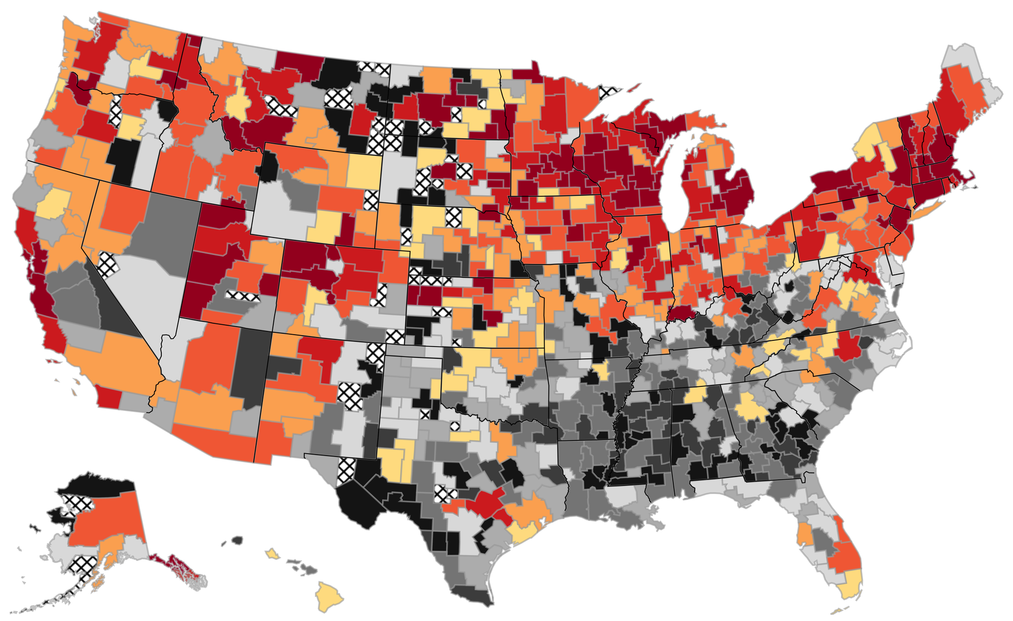
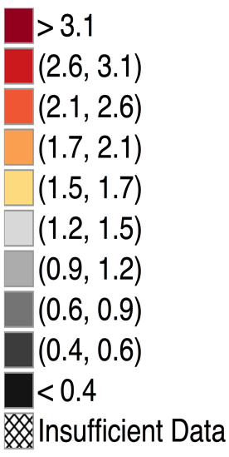
The Origins of Inventors in America
Patent Rates per 1000 Children by Area where Child Grew Up

Slide 48
Patent Rates of Children who Grow up in an Area vs. Patent Rates of Adults in that Area
San Jose
5
Madison
Minneapolis
4
3
Newark
Portland
No. of Inventors Growing up in CZ (per 1000)
2
Houston
1
0
0
0.2
0.4
0.6
0.8
Annual Patent Rate for Working Age Adults in Commuting Zone (per 1000)

Slide 49
Neighborhood Exposure Effects and Innovation
Children raised in areas with more inventors are more likely to be inventors themselves
Could again be driven by genetics or exposure effects
Once again, study patterns within technological class to distinguish the two explanations
  Exact technology class in which a child innovates is strongly related to where he grew up, conditional on location in adulthood
  Kids who grow up in Minneapolis likely to patent in medical devices; kids who grow up in Bay Area likely to patent in computers

Slide 50
Exposure Effects and Gender Gaps in Innovation
Exposure effects are also related to gender gaps in innovation
Girls more likely to become inventors in a particular field if they grow up in an area with more female inventors in that field
Suggests that gender gap can be self-perpetuating
  Under-representation of female scientists in current generation reduces female scientists in next generation

Slide 51
Development of Gender Stereotypes During Childhood
Bian et al. (Science 2017): conduct experiments to analyze development of gender stereotypes about intellectual ability
Present children with pictures of men and women ask them to say who is “really nice” and who is “really smart”
  At age 5: no difference across boys and girls
  At age 6: girls much more likely to choose man as “really smart”
Similarly, girls less likely to choose to play games that are for “children who are really smart” at age 6 than age 5

